Slide 1
Power of Microsoft Graph
Introducing Microsoft Graph and Consuming from SPFX WebParts
Sathish Nadarajan
Nadarajan.Sathish@Gmail.com

Slide 2

Agenda
Introduction to Graph
Accessing the Microsoft Graph from SPFX
Granting Scopes to Azure AD Protected Resources in SharePoint Online
SharePoint Framework’s Microsoft Graph Client
Demo on SPFX WebPart consuming Graph SDK
Intro To Microsoft Graph Data Connect
Demo – Configure and Extract Data from Office 365

Slide 3
Introduction to Graph

Slide 4
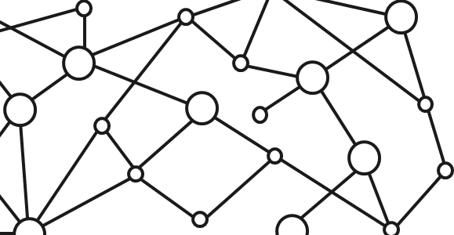
Microsoft 365 Platform
Extend Microsoft 365 experiences
web, device, and service apps
Build your experience
Documents
Pages
Conversations
Timeline
iOS/Android/Windows/Web
1
Microsoft Graph
Notes:
Our Office 365 developer vision focuses on the Users’ experience and their data. As a developer you can bring your applications into their user experience. With over 1.2+ billion users of Office Worldwide, this is a huge opportunity to provide a window into your applications. As well as being able to connect into their data and add intelligence to your applications. There are currently 850 million events created a month and a total of 470Pb+ of data stored in the service that can add value to for our Users’.

Slide 5

Microsoft Graph Gateway to your data in the Microsoft-cloud
https://graph.microsoft.com
Office 365
Windows 10
Enterprise Mobility + Security
Users, Groups, Organizations
Outlook
SharePoint
OneDrive
Teams
Planner
Excel
OneNote
Activities
Device Relay
Commands
Notifications
Azure AD
Intune
Identity Manager
Advanced Threat Analytics
Advanced Threat Protection
Mail, Calendar,
Contacts and Tasks
Sites and Lists
Drives and Files
Channels, Messages
Tasks and Plans
Spreadsheets
Notes, and more…
Identity Management
Access Control
Synchronization
Domains
Administrative Units
Applications and Devices
Advanced Threat Analytics
Advanced Threat Protection
Alerts
Policies
and more…

Slide 6
Microsoft Graph, gateway to Office 365
Single resource that proxies multiple Microsoft services
Allows for easy traversal of objects and relationships
Simplifies token acquisition and management
Eliminates the need to traditional discovery (using “me” and “myorganization”)

Slide 7
Accessing the Microsoft Graph
Direct REST API
Any platform
Any language
Any framework
Native SDKs
Utilize framework & platform specific implementations
Abstracts the details of constructing & processing REST requests over HTTP
.NET, iOS, Android, PhP, Ruby, JavaScript, etc.

Slide 8
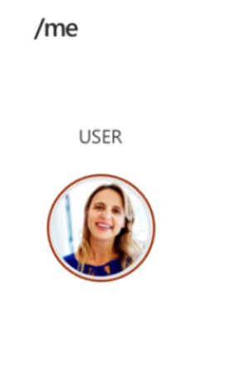
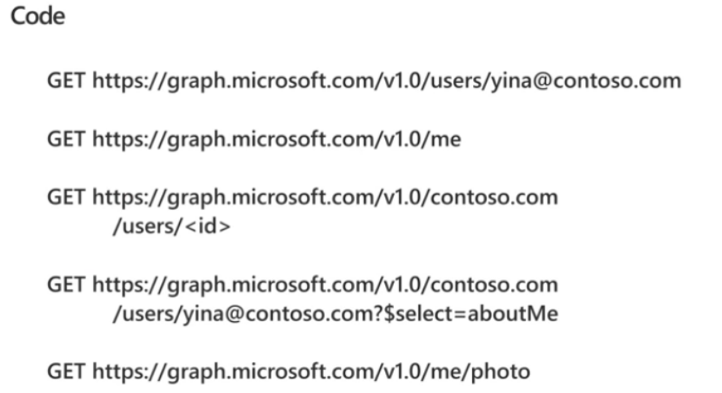

Slide 9
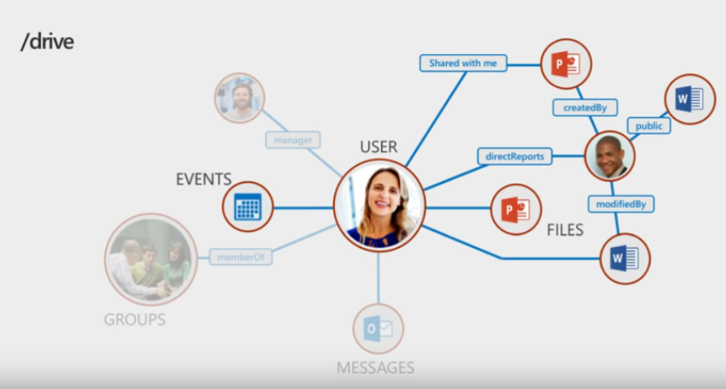

Slide 10
Accessing the Microsoft Graph from the SharePoint Framework

Slide 11
Office 365 and SharePoint Online Users Already Authenticated
Users in Office 365 are already authenticated
SharePoint Online & Office 365 share the same Azure AD dependency as Microsoft Graph
Users login to Office 365 with their Work & School account (Azure AD)
Calls to the Microsoft Graph are proxied through SharePoint Online
Eliminates the need for creation of a separate Azure AD application
Does not bypass any permission / scope requirements
Can only access business entities, not consumer entities

Slide 12
Calling Secured Services from Client-side Code is a Challenge
Calling a secured service, like Microsoft Graph, requires the acquisition of a token
Authenticate and get authorized with Azure AD using an Azure AD application
Interactive login & programmatic acquisition of access token
Client-side applications cannot securely do this across domains seamlessly
Can’t store application ID’s and secrets client side as they cannot be protected
Require an authentication prompt with a popup or redirection

Slide 13
Solution: Proxy Calls to Secured Services through Existing Application
SharePoint Online already has an Azure AD application
Client-side solutions in SharePoint Online call the SharePoint REST API in the same domain
No extra authentication required
Provided these tenants have granted the necessary scopes, SharePoint will call the Microsoft Graph
Responses from the Microsoft Graph are returned back to the client-side application
Permission requests to Azure AD applications (aka: resources) must be approved
Only SharePoint Online tenant administrators can grant / reject permission requests
Approved permissions are available to all client-side solutions in a tenant

Slide 14
Granting Scopes to Azure AD Protected Resources in SharePoint Online

Slide 15
SPFx Solutions Declare Permission Requests
// package-solution.json
{
"$schema": "https://developer.microsoft.com/json-schemas/spfx-build/package-solution.schema.json",
"solution": {
"name": "ms-graph-sp-fx-client-side-solution",
"id": "dfb230b7-4f61-431f-9b65-a34e83922663",
"version": "1.0.0.0",
"includeClientSideAssets": true,
"webApiPermissionRequests": [
{ "resource": "Microsoft Graph", "scope": "User.ReadBasic.All” },
{ "resource": "Microsoft Graph", "scope": "Calendars.Read” },
{ "resource": "Microsoft Graph", "scope": "Tasks.Read” }
]
},
"paths": {
"zippedPackage": "solution/ms-graph-sp-fx.sppkg"
}
}

Slide 16
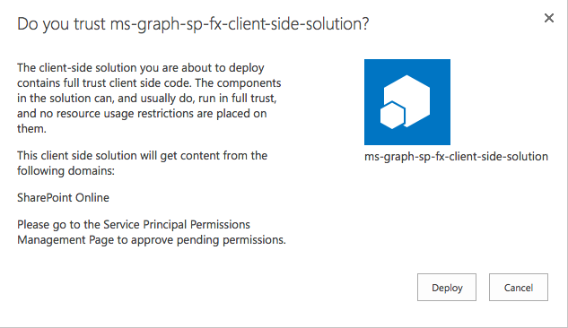
Add SharePoint Package to SharePoint App Catalog
Upload SharePoint packages to the app catalog
Extra note in dialog notifies of additional step required
While application can be installed in SharePoint sites, it does not have the permissions granted that it needs to access Azure AD protected resources

Slide 17
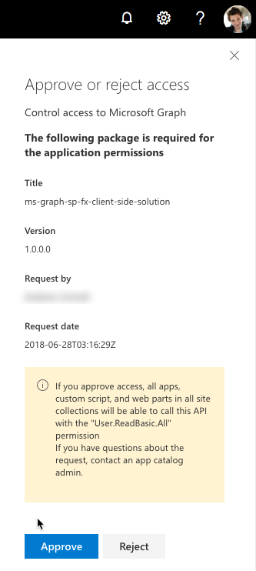
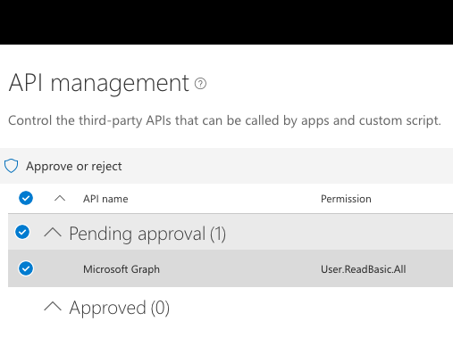
Approve / Reject with SharePoint Online API Management Page
https://{{REPLACE_WITH_YOUR_TENANTID}}-admin.sharepoint.com/_layouts/15/online/AdminHome.aspx

Slide 18
SharePoint Framework’s Microsoft Graph Client

Slide 19
Microsoft Graph JavaScript SDK
Microsoft Graph is accessible via REST API & various SDKs
Client-side solutions can leverage the JavaScript SDK
https://github.com/microsoftgraph/msgraph-sdk-javascript
Requires initialization with an Azure AD provided OAuth2 access token to create the client
Notes:
Let’s review from the previous section

Slide 20
Initializing the Microsoft Graph JS SDK
var client = MicrosoftGraph.Client.init({
authProvider: (done) => {
done(null, access_token);
}
});
client
.api('/me')
.get((err, res) => {
console.log(res);
});

Slide 21
Microsoft Graph TypeScript Type Declarations
Use the Microsoft Graph JavaScript SDK in TypeScript applications
TypeScript type declarations introduce strong types and documentation to client-side projects
https://github.com/microsoftgraph/msgraph-typescript-typings

Slide 22
Microsoft Graph TypeScript Type Declarations
import * as MicrosoftGraph from '@microsoft/microsoft-graph-types';
// init Microsoft Graph client
client
.api('/me')
.get((error: any, user: MicrosoftGraph.User, rawResponse?: any) => {
console.log('name: ', user.displayName);
console.log('email: ', user.displmailayName);
console.log('phone: ', user.businessPhones[0]);
});
});

Slide 23
SharePoint Framework Includes a Microsoft Graph Client
MSGraphClient: SharePoint Framework’s Microsoft Graph Client
Abstracts the token acquisition from the SharePoint Framework’s support for Azure AD
Wraps the Microsoft Graph JavaScript SDK and initializes it with one line that returns a promise
this.context.msGraphClientFactory
.getClient()
.then((client: MSGraphClient): void => {
// use MSGraphClient here
});

Slide 24
Demo Accessing User Details from the Microsoft Graph in a SharePoint Framework Client-Side Web Part

Slide 25

Summary
The Microsoft Graph REST API enables any application using any language on any platform to access organization data provided they have appropriate permissions
Azure AD is the single dependency shared between both the Microsoft Graph and Office 365’s SharePoint Online
SharePoint can simplify the authentication process to access the Microsoft Graph as users are already logged into Azure AD
Users of Office 365 and SharePoint Online are already authenticated with their Azure AD work or school account
Tenant administrators grant Microsoft Graph scopes to SharePoint Online tenants
All client–side calls from that tenant proxy requests to the Microsoft Graph via the SharePoint Azure AD application

Slide 26
Microsoft Graph Data Connect
Introducing Microsoft Graph data connect & configuring your Office 365 tenant

Slide 27

Microsoft Graph Data Connect
What is Microsoft Graph data connect?
What types of scenarios does Microsoft Graph data connect enable?
Configuring your Office 365 tenant to enable Microsoft Graph data connect

Slide 28
What are customers trying to do?
Better CRM
Security and Fraud
Optimize Your Organization​
Build & Integrate Intelligent Workflows with O365​
Mine your org network for a customer introduction
Opportunity health assessment​
Detect fraud with productivity and communication data
Mine communication for interaction patterns with users outside the organization
Find an expert​
Automate knowledge base creation​
Understand resource utilization within your organization
Case management
Questions & answers bot
Support ticket management
Analytics
AI and ML
Index and Search

Slide 29
Challenging scenarios with the Microsoft Graph
Today’s most interesting data-driven applications
require reasoning & analysis over massive datasets
built by extracting data from Office 365 via Microsoft Graph APIs
Microsoft Graph is optimized for simple, real-time, entity centric queries, not:
Data Access in bulk - requires expensive engineering
Data Privacy is at risk - given the current all-or-nothing consent models
Data Security & Data Governance - entirely up to the experience author

Slide 30







Microsoft Graph Data Connect
Apply defined data controls
Securely extend Office 365 data to Azure
Enable big data and machine learning
Data at scale
Office 365
Azure
Customer data
Granular consent
Product data
Security & Governance
Industry data
Customer’s MS Cloud

Slide 31
What is Microsoft Graph Data Connect?
Creates a new model for data access & hosting applications within the customer’s control
Allows developers to build intelligent applications and experiences using Office 365 data & Azure resources
Application access to customer data requires explicit customer approval
Microsoft Graph remains the best approach for enabling end-user task centric apps

Slide 32
Comparing Microsoft Graph APIs & Microsoft Graph Data Connect
 | Graph APIs | Graph data connect
Access scope | Single use / entire tenant | Many users / groups
Access pattern | Real time | Recurrent schedule
Data operations | Operates on data master | Operates on cache of the data
Data protection | Data is protected while in Microsoft 365 | Data protection is extended to the cache of data in your Azure subscription
User consent | Self; resource types | None
Admin consent | Entire organization; resource types | Select groups of users; resource types & properties; excludes users
Access tools | RESTful web queries | Azure Data Factory

Slide 33
Graph Data Connect - Enabling Scenarios
Data resides in Office 365
Azure Data Factory extracts data via Graph data connect
Graph data connect enforces only approved requests for data
Extracted data is stored in Azure:
Azure Blob Storage
Azure Data Lake
Create solutions that leverage the data in Azure

Slide 34



Insight examples for organizations
Build a better CRM. Connect your organizational network for a customer introduction.
Engage your customers
Transform products
Build & integrate intelligent workflows with Office 365 for your business and industry.​ Leverage knowledge to improve legal case management.
Your Data +
Workplace Analytics
Azure
Connect employees with the best expert. Abstract trends to automate knowledge management.
Optimize your organization​
Streamline operations
Detect fraud with productivity and communication data.
Connect interaction patterns with users outside the organization.

Slide 35
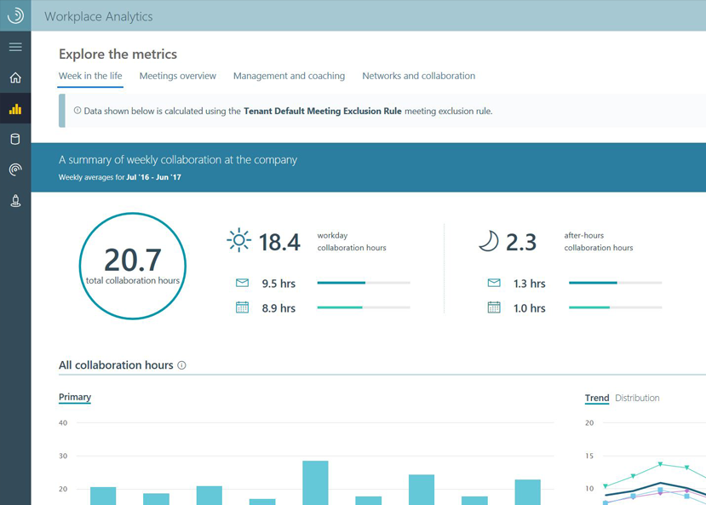
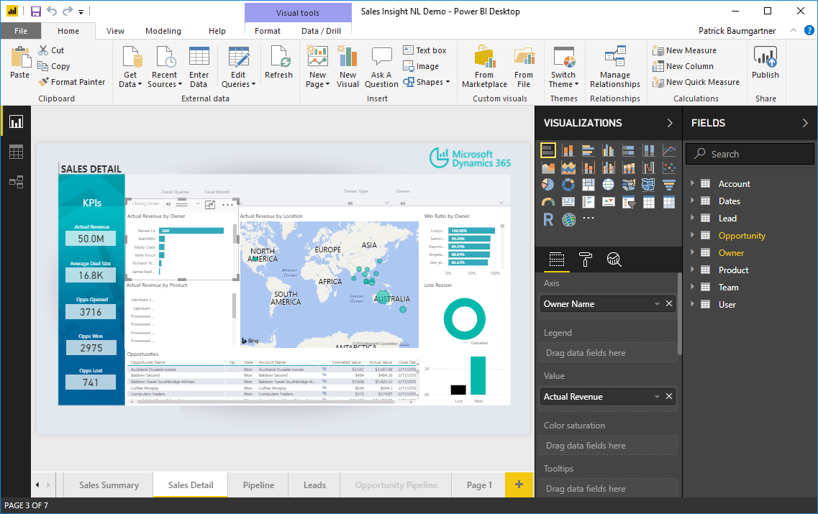
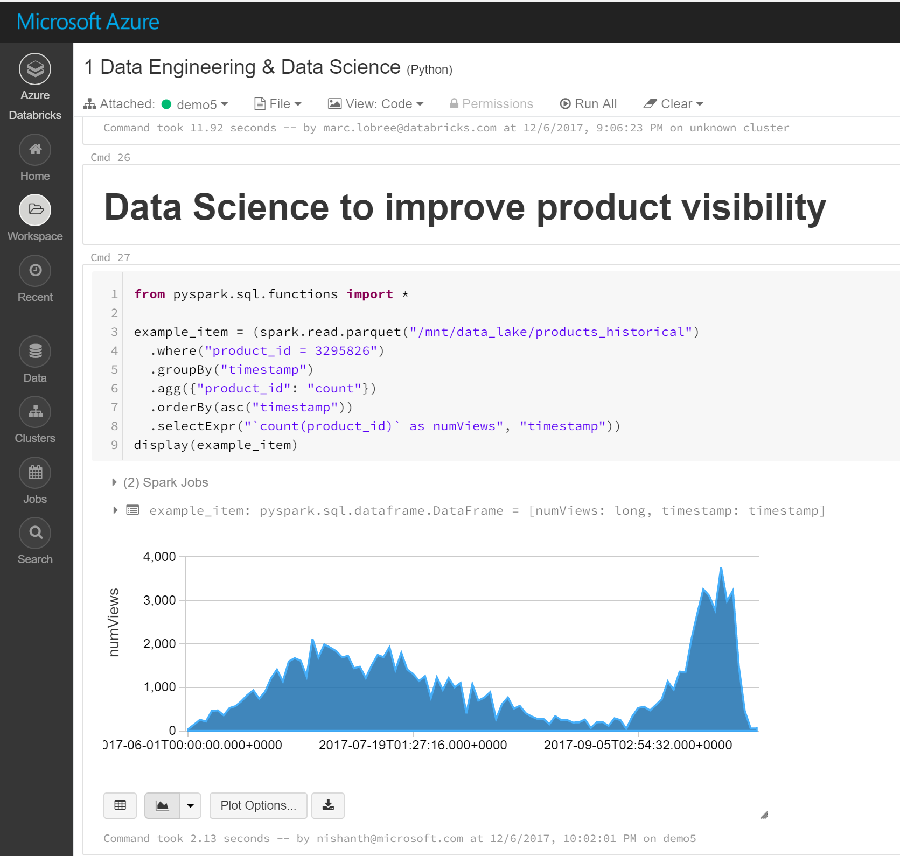


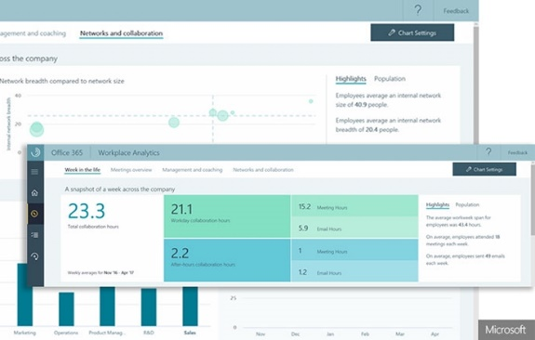
Create insight applications in the Enterprise
Anyone can develop custom insights using key organizational data
Decision makers
Business analysts
Developers
Workplace Analytics
Create self-service customization
Harness full AI tool suites and frameworks
Insights apps
Unlock valuable insights in hours

Slide 36
Demo Configuring Your Office 365 Environment Extract the Data https://portal.office.com/adminportal/home#/Settings/PrivilegedAccess

Slide 37
Summary
What is Microsoft Graph data connect?
What types of scenarios does Microsoft Graph data connect enable?
Configuring your Office 365 tenant to enable Microsoft Graph data connect
Create a data sink where extracted data will go
Create Azure Data Factory pipeline
Approve data request

Slide 38
Reading further
Consume Microsoft Graph (tutorial)
https://docs.microsoft.com/sharepoint/dev/spfx/use-aad-tutorial
Microsoft Graph
https://developer.microsoft.com/graph
Microsoft Graph JavaScript SDK
https://github.com/microsoftgraph/msgraph-sdk-javascript
SharePoint Framework Documentation
https://docs.microsoft.com/sharepoint/dev/spfx/sharepoint-framework-overview
Use the MSGraphClient to Connect to Microsoft Graph
https://docs.microsoft.com/sharepoint/dev/spfx/use-msgraph
Microsoft Graph
https://developer.microsoft.com/graph
Graph Explorer
https://developer.microsoft.com/graph/graph-explorer
Microsoft Graph JavaScript SDK
https://github.com/microsoftgraph/msgraph-sdk-javascript
SharePoint Framework Documentation
https://docs.microsoft.com/sharepoint/dev/spfx/sharepoint-framework-overview
Use the MSGraphClient to Connect to Microsoft Graph
https://docs.microsoft.com/sharepoint/dev/spfx/use-msgraph

